Slide 1



GO
BANANAS
DAY
AT SCHOOL

Slide 2
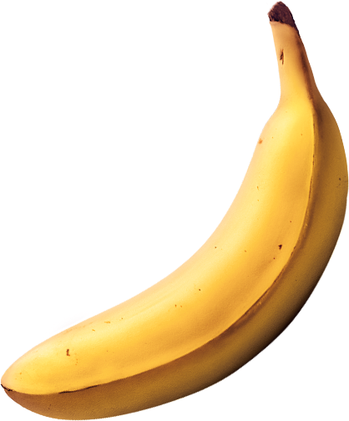

Mind
Bending
Facts

Slide 3

At over 10,000 years old, bananas are the world’s oldest fruit
That’s about 5 times older than the Colosseum in Italy, or the Parthenon in Greece, which are around 2,000 years old!

Slide 4

Australians munch through 5,000,000 bananas every day
If you put each banana end to end it would stretch from Sydney to Melbourne.

Slide 5
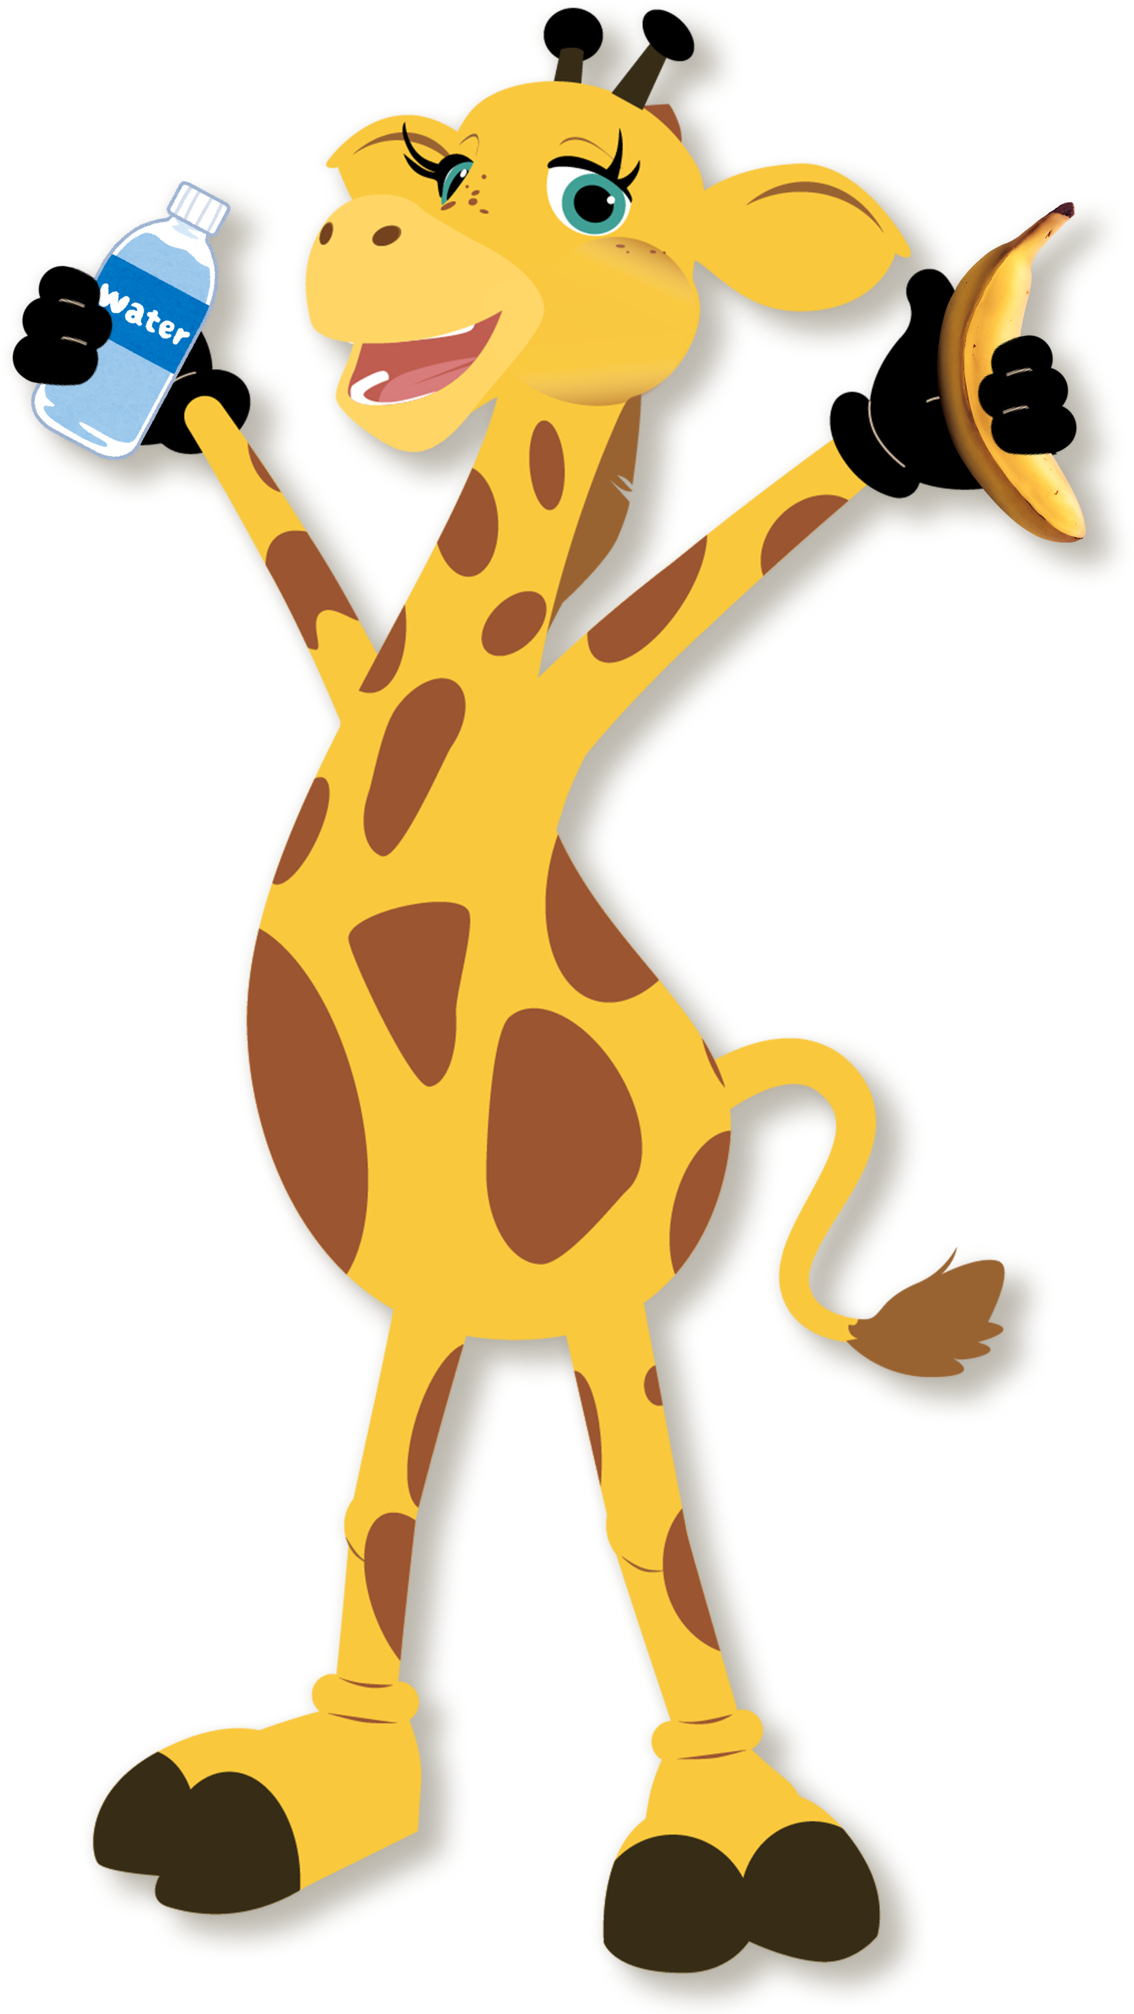
Despite their texture, bananas are composed of 75% water
That’s even more than a human body, which is 60% water.

Slide 6

Jokes That Are
Simply Bananas

Slide 7


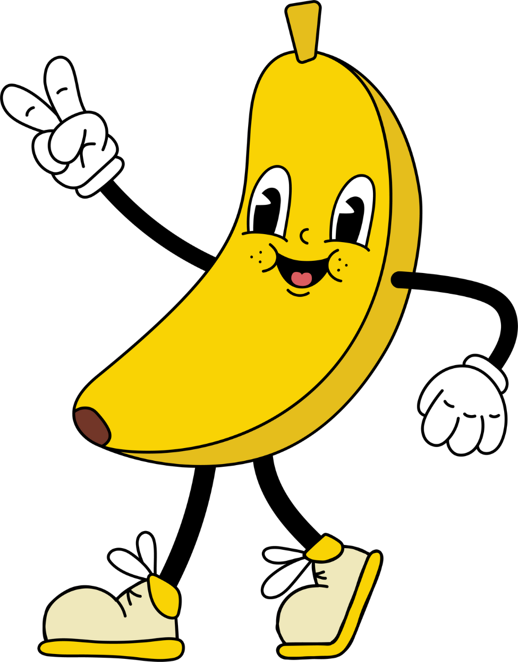

Why did the banana go to the hairdressers?
?
Because
it had
split ends!

Slide 8
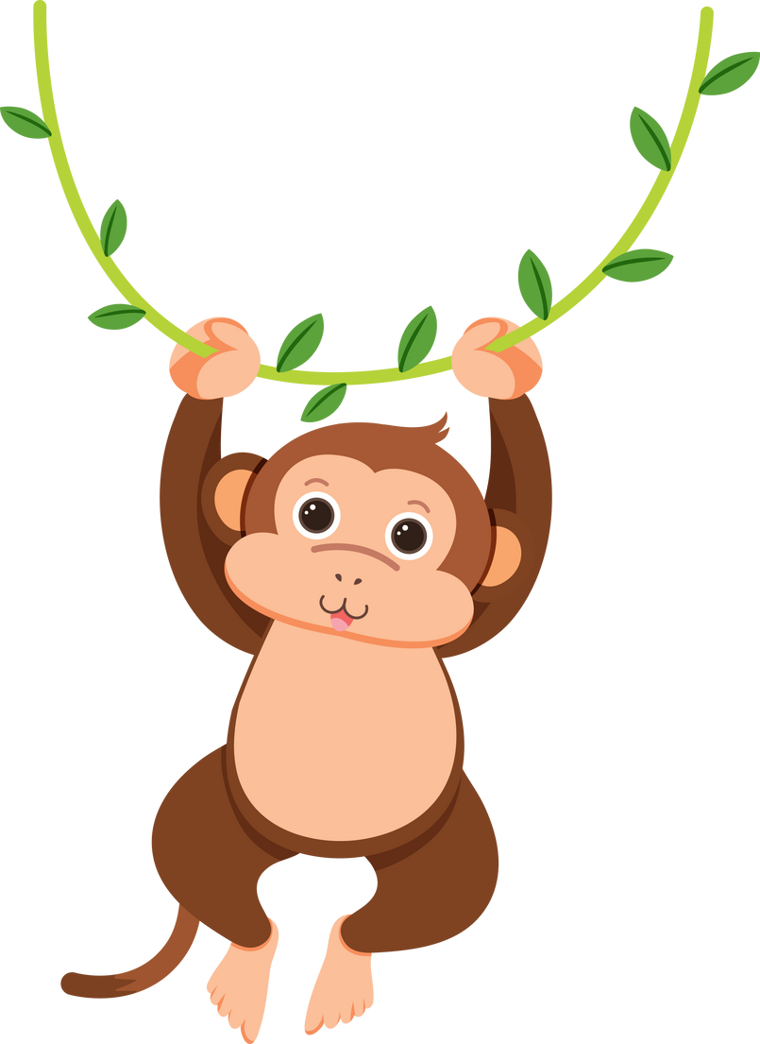
What kind of key opens a banana?
?
A MONKEY

Slide 9

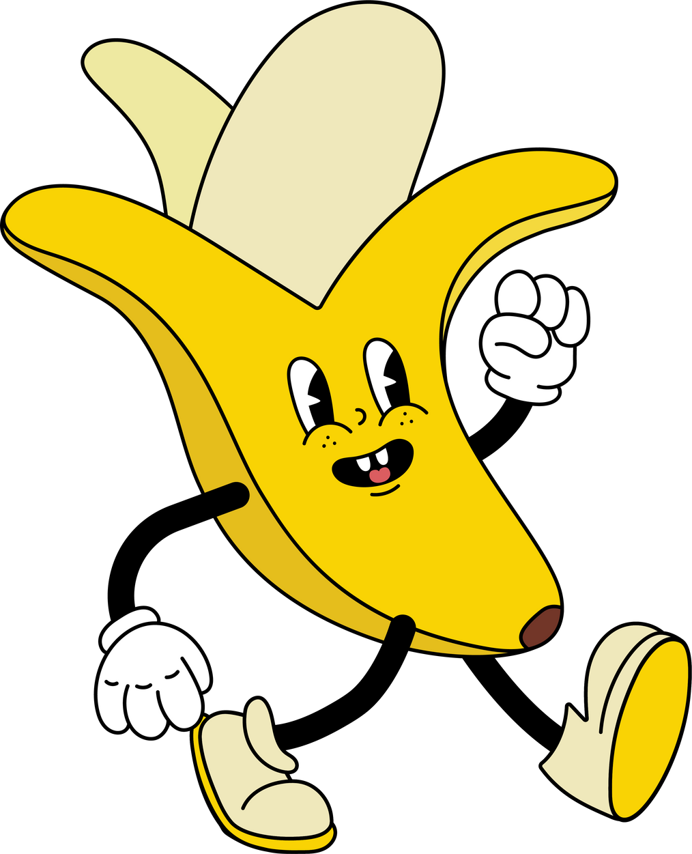

Yellow?
What do bananas say when they answer the phone?

Slide 10
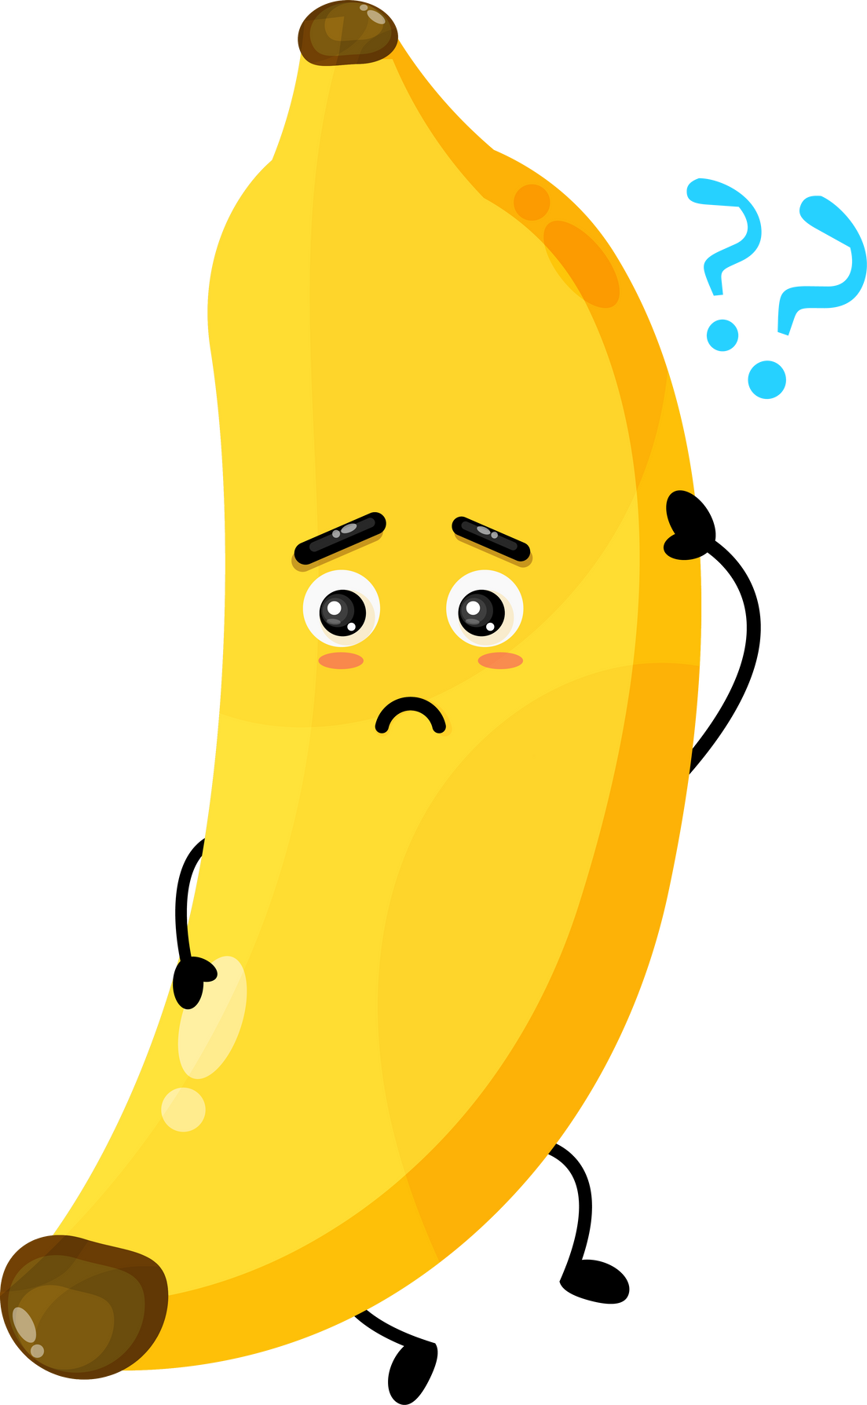
Why didn’t the young banana go to school?
It wasn’t peeling well!

Slide 11
Why Are
Bananas
Awesome?

Slide 12


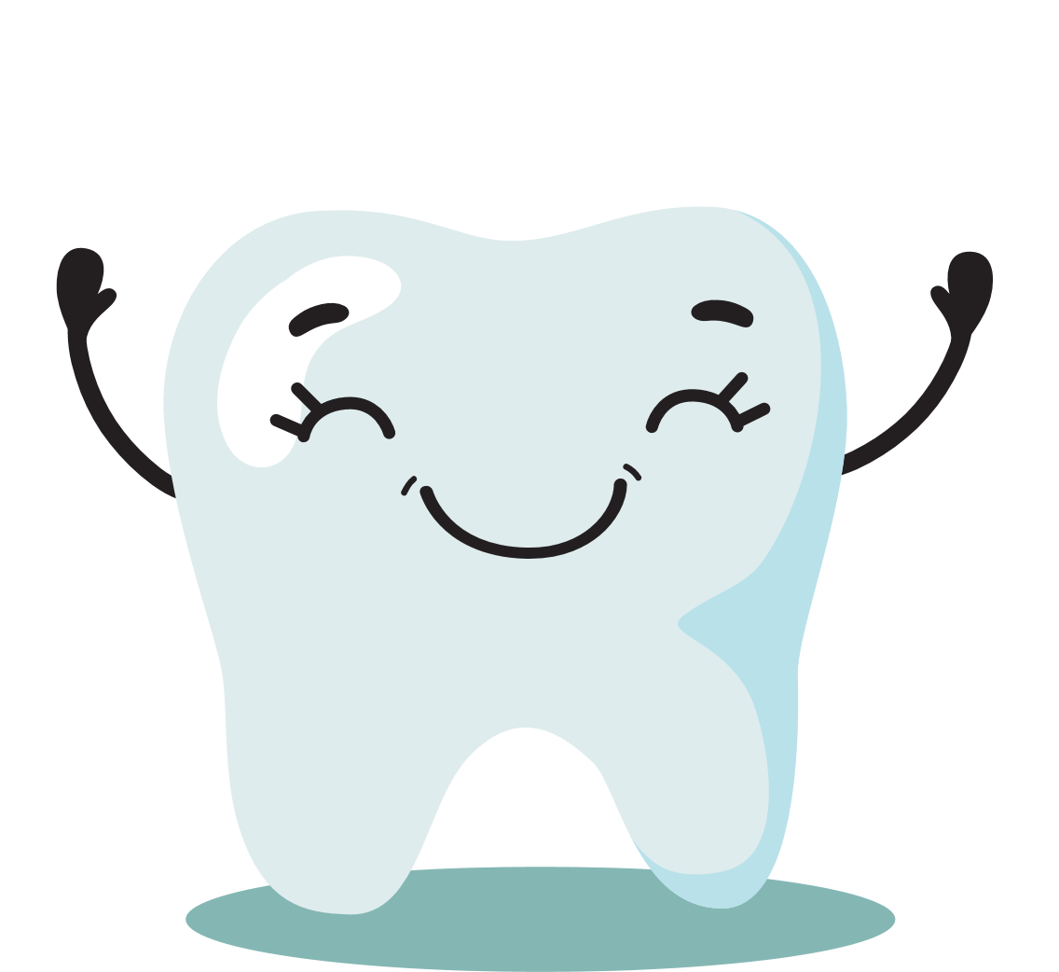


Super energy boost!
Packed with vitamins
Bananas are a great source of carbohydrates that give you energy to play and learn!
They have Vitamin C, which helps keep you healthy and strong!
Strong bones and teeth
Happy Tummy!
Bananas contain potassium, which helps your muscles and bones stay strong.
They have fiber, which is good for your digestion and keeps your tummy happy!
Easy to eat!
Just peel and enjoy! Perfect for snacks or lunchboxes!

